Slide 1




NearCare
Presented by,
Aravindharaj Rajendran
Niranjan Ravichandran
Rakesh Balan Lingakumar

Slide 2
Objective
The aim of the project is to help users insightfully search for better-performing hospitals based on hospital’s performance measures such as,
Rate of Mortality
Rate of Complication
Patient Experience
Medicare Coverage
Using the above measures, a Credible Factor is calculated and assigned to every hospital.
With location as an input, the list of highly recommended hospitals based on Credible Factor are displayed.

Slide 3
Data Cleansing
Credible Factor is calculated by taking the average of all the performance measures.
Challenges:
The performance measures has an ideal score of higher or lower which invalidates the average calculation. So, measures with lower ideal scores are inversed before calculating the average.
Duplicate hospital records
Null Values

Slide 4
Features
Search by current location/custom location and type of hospital.
Shows the list of recommended hospitals with its CREDIBLE FACTOR
Ability to contact the hospital directly through the iOS app.
Shows the recommended hospitals in Maps around the input location.
Visualize the performance measure of every hospitals.

Slide 5
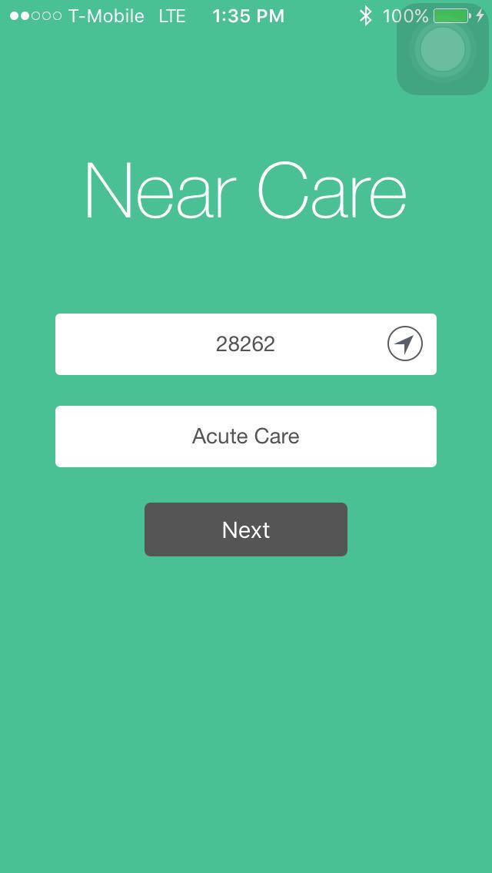
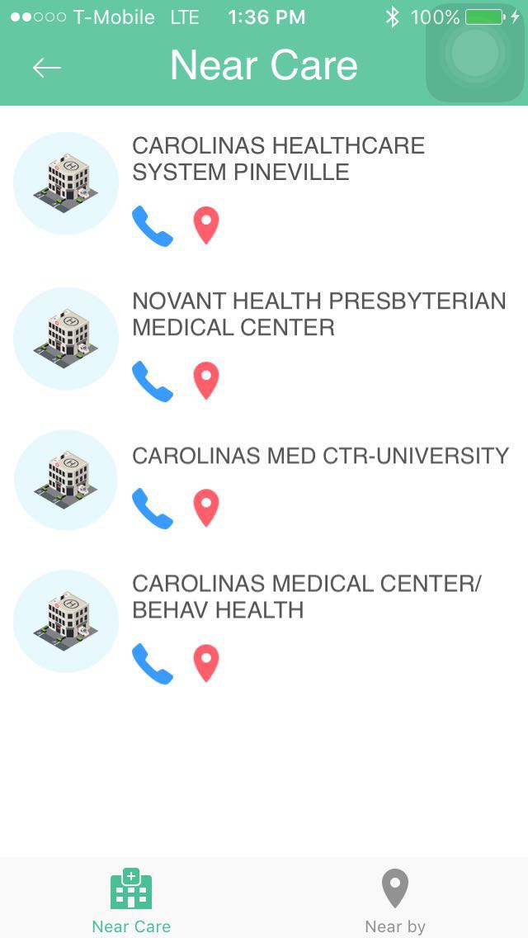
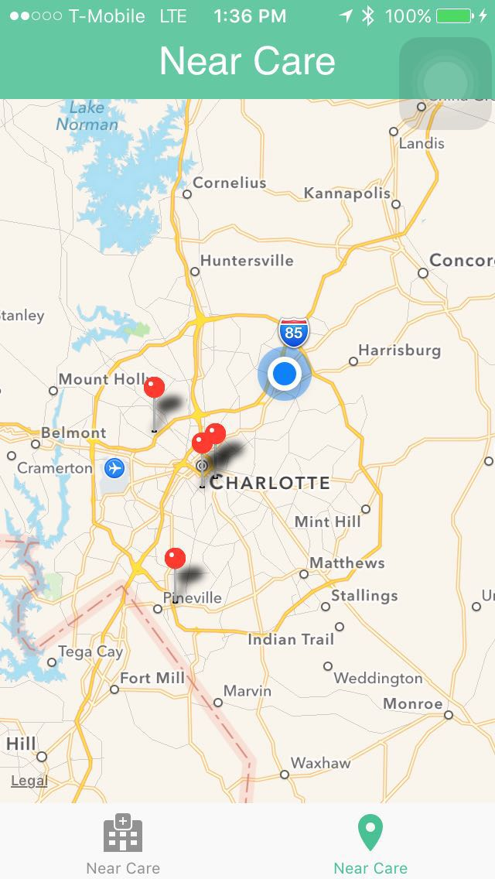
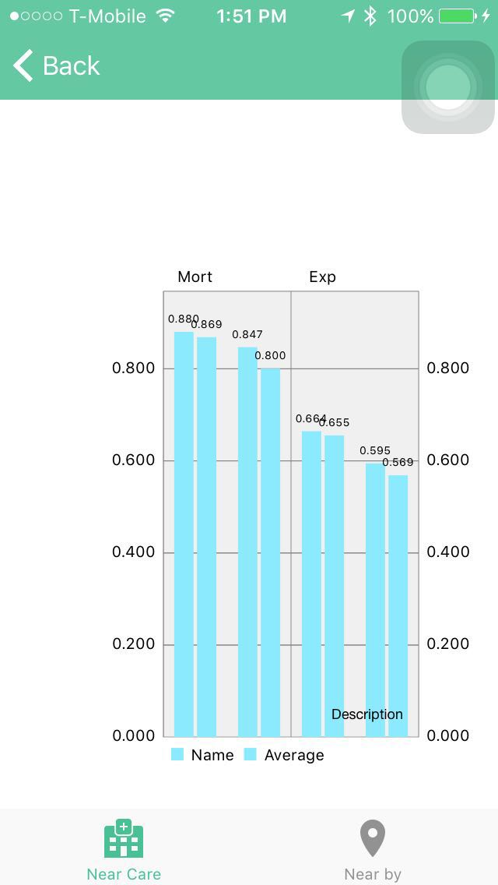
Screenshots

